Slide 1
HANDWRITTEN NUMBER RECOGNITION USING KERAS AND TENSORFLOW
PRESENTED BY : A.S.NIVETHETHAA
REG NO : 813821205038
DEPT : INFORMATION TECHNOLOGY
COLLEGE : SARANATHAN COLLEGE OF ENGINEERING
NM ID : nivethethaaas@gmail.com
(au813821205038)
3/21/2024 Annual Review

Slide 2
PROJECT TITLE
Handwritten Number Recognition using Keras and Tensorflow
3/21/2024 Annual Review

Slide 3


AGENDA
PROBLEM STATEMENT
PROJECT OVERVIEW
WHO ARE THE END USERS?
YOUR SOLUTIONS AND ITS VALUE PROPOSITION
THE WOW IN YOUR SOLUTION
MODELLING
RESULTS
3/21/2024 Annual Review

Slide 4

PROBLEM STATEMENT
Handwritten digit recognition is a fundamental problem in the field of computer vision and machine learning. It involves creating a machine learning algorithm or model capable of accurately identifying and classifying handwritten numbers (0-9) based on input images. The goal is to develop a system that can automatically recognize and classify handwritten digits with high accuracy, which is crucial for applications such as optical character recognition (OCR), digitization of documents, and automation of tasks involving handwritten data. The model should be trained on a dataset of labeled handwritten digits and evaluated on its ability to correctly classify unseen handwritten digits. In this project, our goal is to develop a deep neural network model that accurately classifies handwritten digits from the dataset.
3/21/2024 Annual Review

Slide 5

PROJECT OVERVIEW
Recently Deep Convolutional Neural Networks (CNNs) becomes one of the most appealing approaches and has been a crucial factor in the variety of recent success and challenging machine learning applications such as object detection, and face recognition. Therefore, CNNs is considered our main model for our challenging tasks of image classification. Specifically, it is used for is one of high research and business transactions. Handwriting digit recognition application is used in different tasks of our real-life time purposes. Precisely, it is used in vehicle number plate detection, banks for reading checks, post offices for sorting letter, and many other related tasks.
3/21/2024 Annual Review

Slide 6

WHO ARE THE END USERS?
GENERAL PUBLIC
ADMINISTRATIVE STAFF
FINANCIAL INSTITUTIONS
MEDICAL PROFESSIONALS
RETAIL AND E-COMMERCE
MANUFACTURING AND LOGISTICS
EDUCATIONAL INSTITUTIONS
3/21/2024 Annual Review

Slide 7
YOUR SOLUTION AND ITS VALUE PROPOSITION
The solution to the provided problem statement involves several steps:
Data Acquisition and Preprocessing
Model Training
Model Evaluation
Testing and Deployment
Documentation and Maintenance
Value Proposition:
Accuracy and Precision
Efficiency and Automation
Cost Reduction
Enhanced Customer Experience
Innovation and Competitive Advantage
3/21/2024 Annual Review

Slide 8
THE WOW IN YOUR SOLUTION
Accuracy: With the power of convolutional neural networks (CNNs), Keras, and TensorFlow, you can achieve high accuracy in recognizing handwritten digits.
Efficiency: Keras provides a user-friendly interface for building and training neural networks, while TensorFlow optimizes the computational efficiency under the hood.
Flexibility: Keras allows for easy experimentation with different network architectures and hyperparameters, enabling you to fine-tune the model to achieve the best performance for your specific dataset and requirements.
Scalability: TensorFlow's scalability allows you to train models on large datasets distributed across multiple GPUs or TPUs, making it suitable for industrial-scale applications. This scalability ensures that the model can handle real-world scenarios with high volumes of data.
Community Support: Both Keras and TensorFlow have large and active communities, providing extensive documentation, tutorials, and pre-trained models.
3/21/2024 Annual Review
8

Slide 9
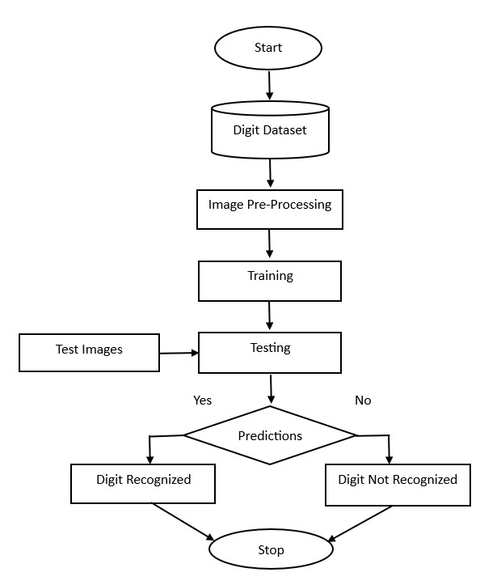
MODELLING
3/21/2024 Annual Review
9

Slide 10
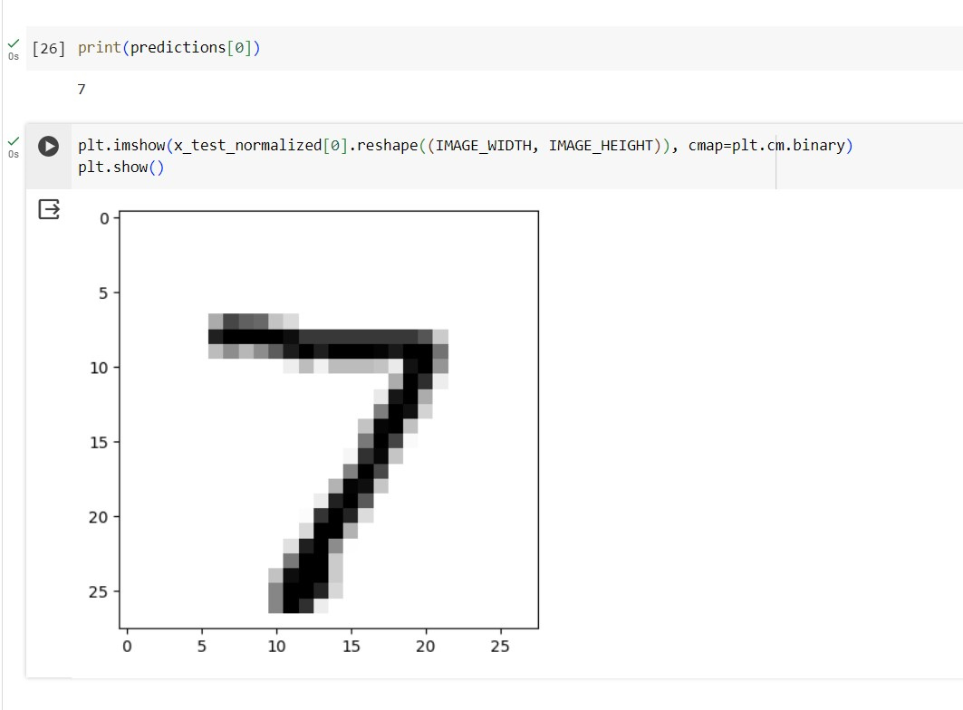
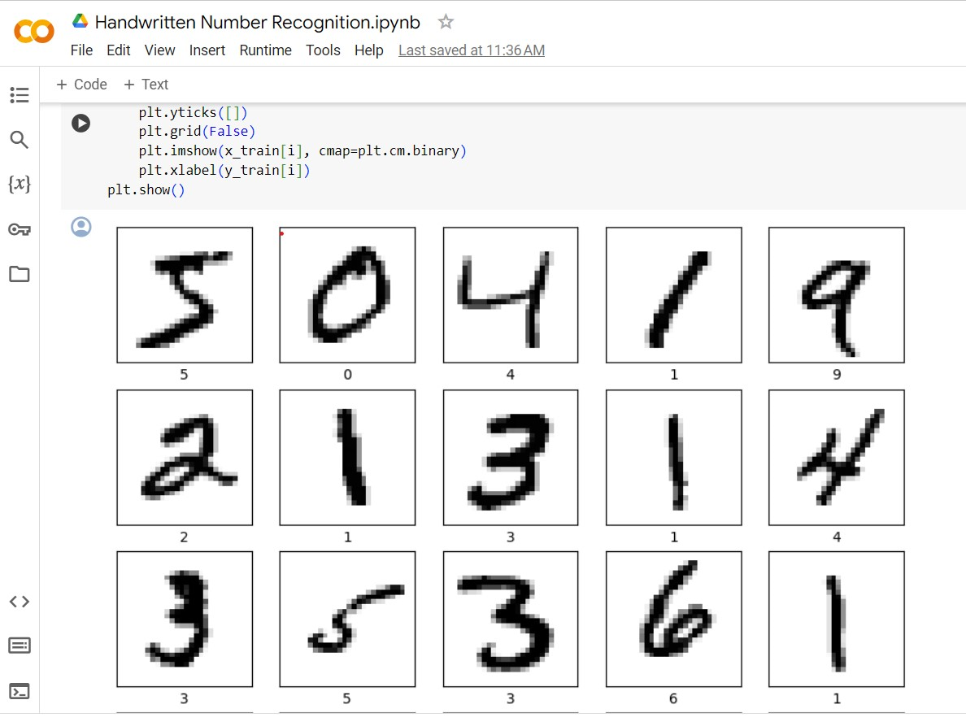
RESULTS
https://github.com/NivethethaaSenthilkumar/TNSDC-Generative-AI
3/21/2024 Annual Review
10

